Slide 1
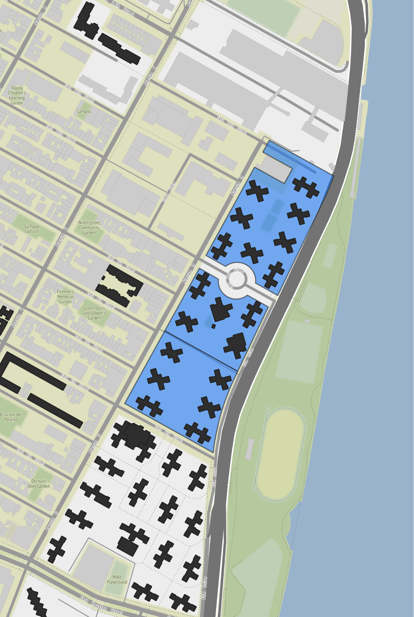
Riis Houses
T.A. President: Daphne Williams
Overview
Official Adult Pop. 3,009
Registered Voters 2,698
Highest Turnout Election 2020 Gen.
Lowest Turnout Election 2017 Prim.
Voter Turnout in Recent Elections
Election | General | Primary
2021 (Municipal) | 14.6% | 13.5%
2020 (Presidential) | 40.9% | 11.1%
2018 (Gubernatorial) | 28.2% | 16.1%
2017 (Municipal) | 13.9% | 10.6%
2016 (Presidential) | 40.1% | 16.8%
2021 TA Turnout: 2.59%

Slide 2
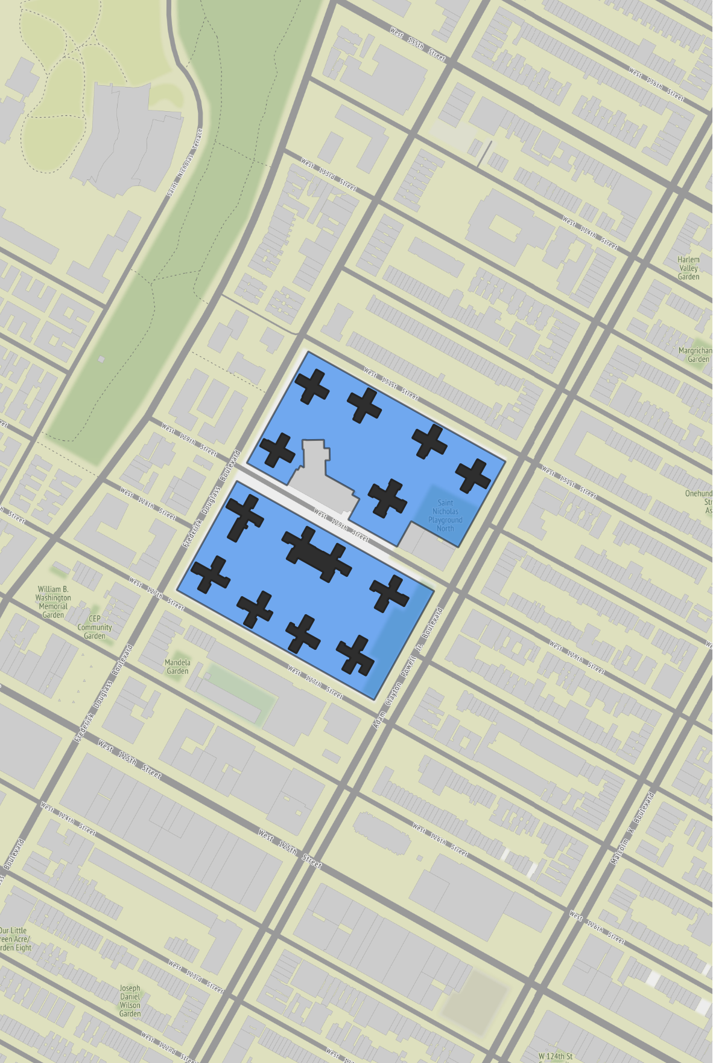
Saint Nicholas Houses
T.A. President: Leslie Johnson
Overview
Official Adult Pop. 2,409
Registered Voters 2,925
Highest Turnout Election 2016 Gen.
Lowest Turnout Election 2017 Prim.
Voter Turnout in Recent Elections
Election | General | Primary
2021 (Municipal) | 15.9% | 15.3%
2020 (Presidential) | 42.5% | 12.8%
2018 (Gubernatorial) | 35.2% | 17.5%
2017 (Municipal) | 10.7% | 9.6%
2016 (Presidential) | 47.7% | 22.3%
2022 TA Turnout: 4.75%

Slide 3
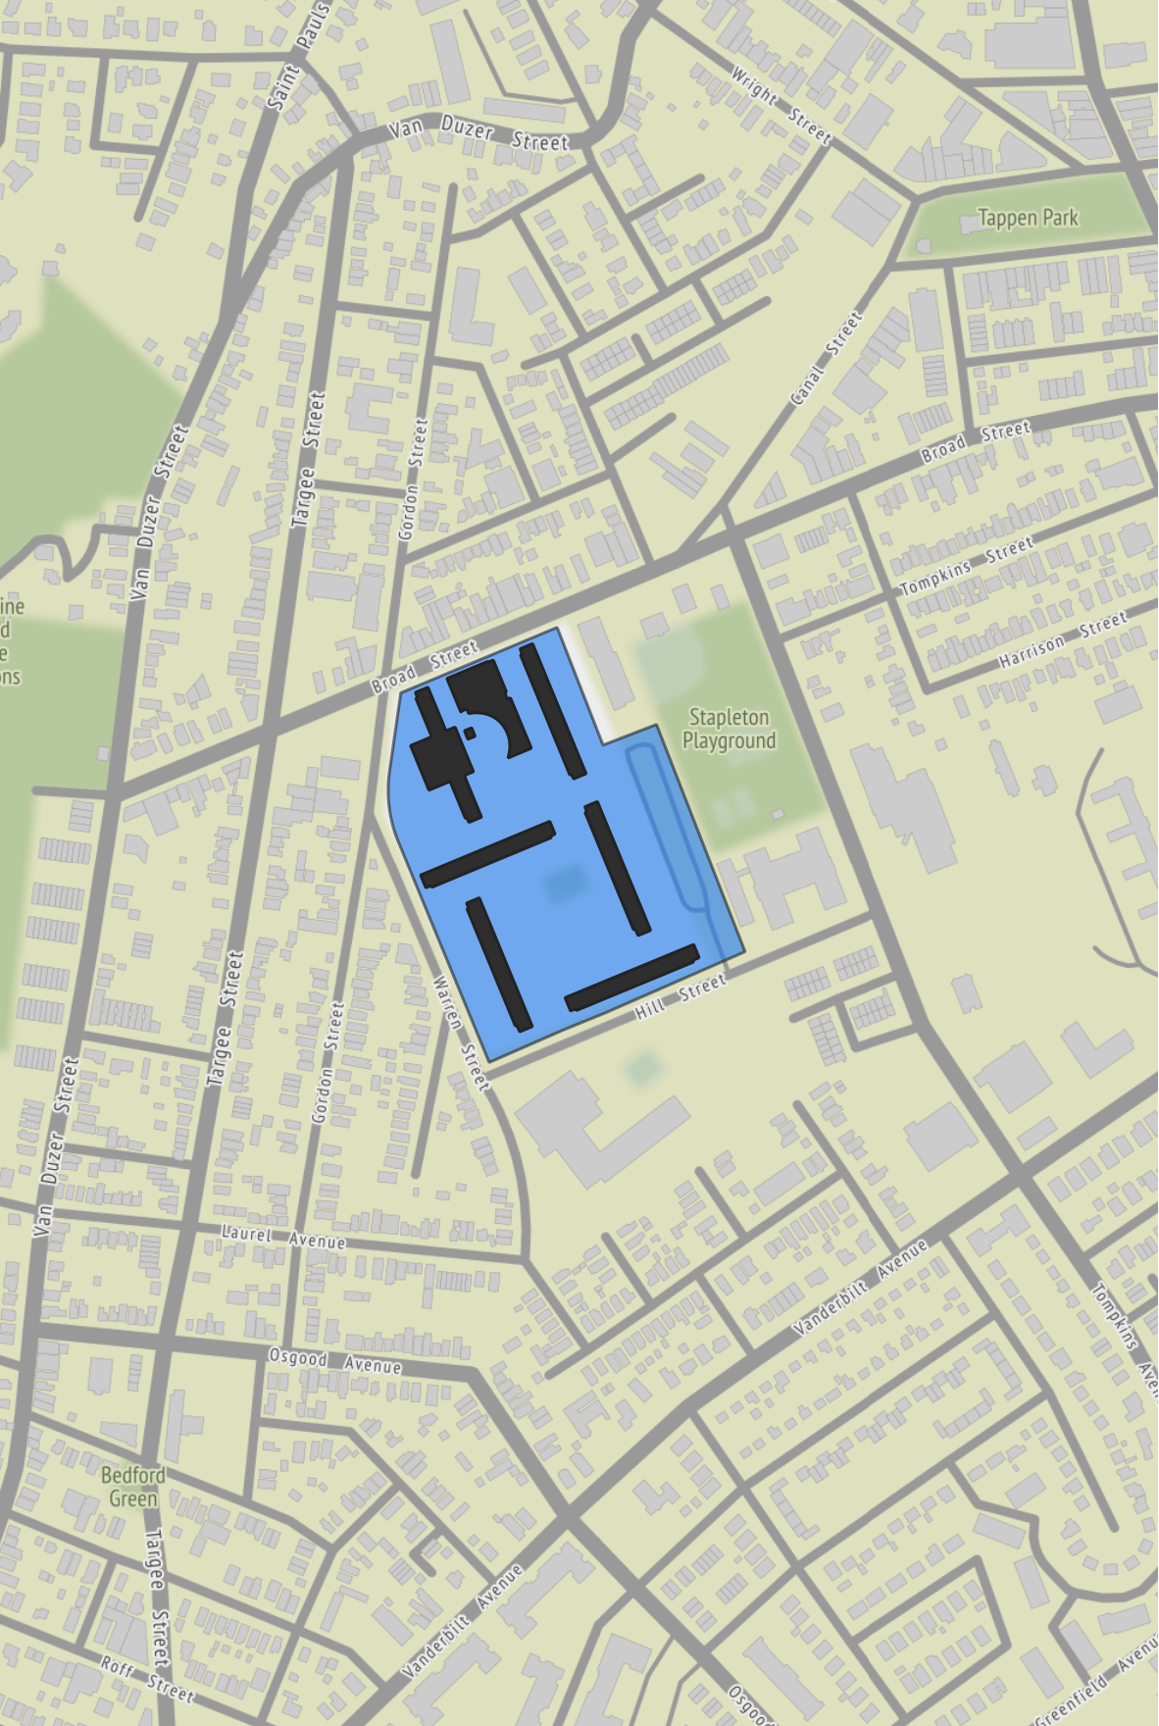
Stapleton Houses
T.A. President: Geraldine Parker
Overview
Official Adult Pop. 1,222
Registered Voters 1,301
Highest Turnout Election 2016 Gen.
Lowest Turnout Election 2017 Prim.
Voter Turnout in Recent Elections
Election | General | Primary
2021 (Municipal) | 19.5% | 14.0%
2020 (Presidential) | 31.7% | 9.3%
2018 (Gubernatorial) | 32.0% | 14.6%
2017 (Municipal) | 14.2% | 8.7%
2016 (Presidential) | 42.4% | 16.8%
2021 - 2022 TA turnout data not available

